Slide 1



Supervoxel-Based Hierarchical Markov Random Field Framework for Multi-Atlas Segmentation
Ning Yu¹, Hongzhi Wang² and Paul A Yushkevich³
^{1:}Department of Computer Science, University of Virginia ^{2:}IBM Almaden Research Center ^{3:}Penn Image Computing and Science Laboratory, Department of Radiology, University of Pennsylvania
MICCAI 2016 PATCH-MI Workshop
October 17, 2016, Athens Greece
This research is supported by NIH grant R01 EB017255

Slide 2
Overview
Our prior work on joint label fusion
Works great when you can do dense deformable registration
Can we do label fusion without dense deformable registration?
Supervoxel matching without spatial context
Supervoxel matching with discrete MRF registration (“new” method)
Initial results and further thoughts…

Slide 3
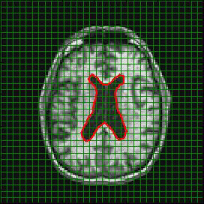
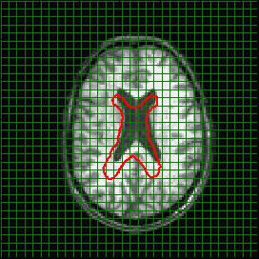
”Conventional” multi-atlas segmentation involves dense deformable registration
ANTS, IRTK, LDDMM, etc.
Atlas j
Target

Slide 4
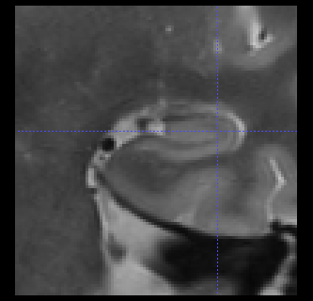
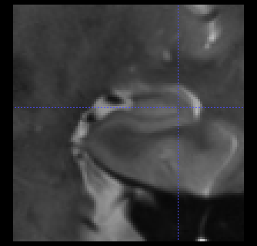
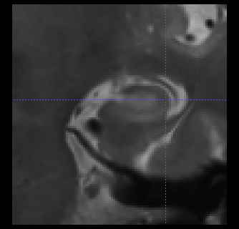
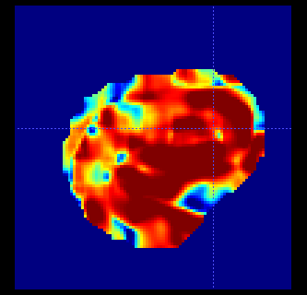
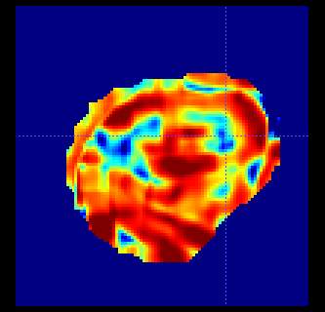
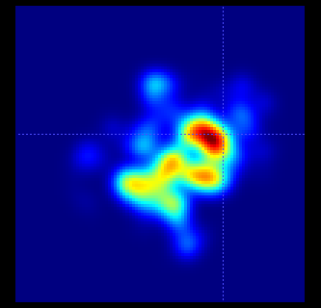
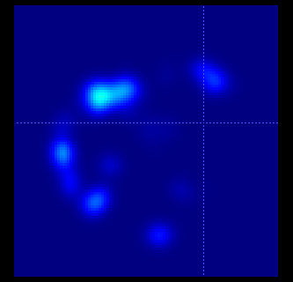
Label fusion by similarity-weighted voting
target
target image
warped atlas 1
warped atlas k
atlas image 1
atlas image n
similarity map
similarity map
weight map
weight map

Slide 5
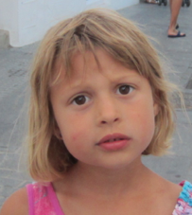
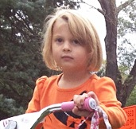

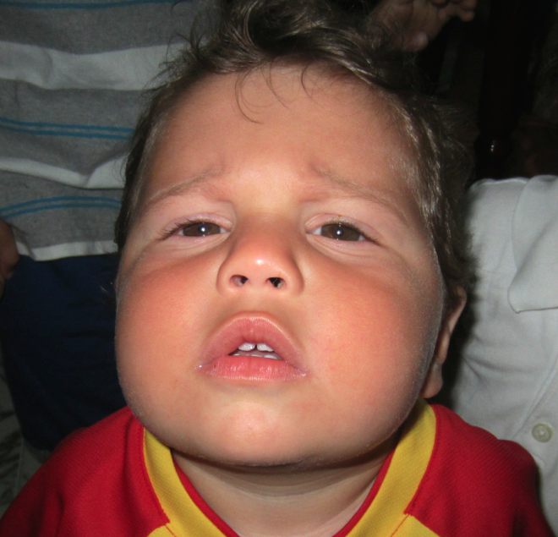
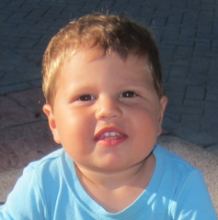
Redundancy in similarity-weighted label fusion
µ=2
µ=2
µ=2
µ=4
Total weight:
Daughter: 0.6
Son: 0.5
Notes:
redundanica

Slide 6
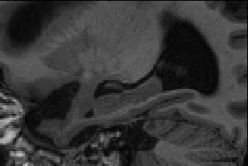
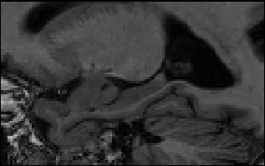
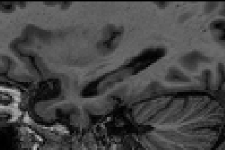
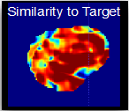
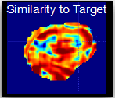
Joint Label Fusion (Wang et al., IEEE-PAMI 2013): Account for correlation/redundancy between atlases
Independent label fusion
Joint label fusion
target image
target image
atlas image 1
atlas image n
atlas image 1
atlas image n
pairwise correlations are considered
voting map 1
voting map n
voting map 1
voting map n
Notes:
Related to Tumer and Ghosh, 1995 work on correlation in ensemble classifiers

Slide 7
Joint Label Fusion formulation: at each voxel, find atlas weights that minimize expected total segmentation error
Wang et al., IPMI 2011, IEEE PAMI 2012

Slide 8
Formulation: find vector of atlas weights that minimizes expected total segmentation error
Wang et al., IPMI 2011, IEEE PAMI 2012

Slide 9
Corrective learning (Wang et al., 2011): a wrapper method to improve the performance of existing segmentation algorithms using training data
Wang et al., Neuroimage, 2011
Notes:
Aprende de conocer y corregir
Patrones de desacuerdo
Voxeles mal etiquetados

Slide 10
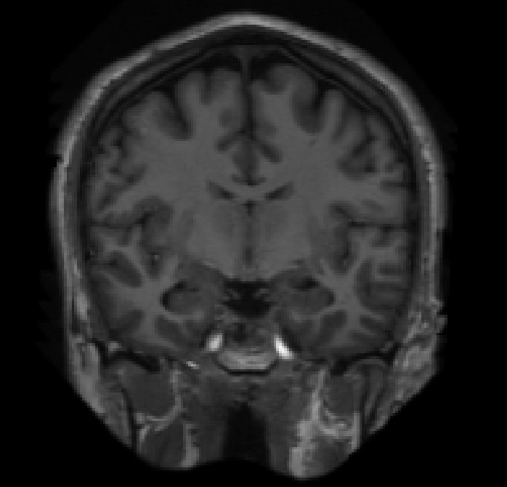
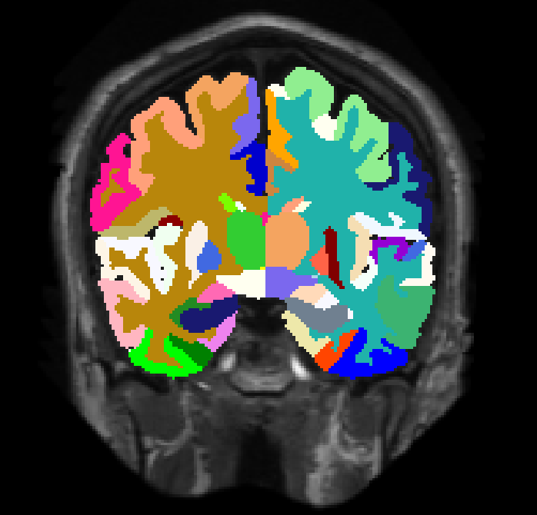
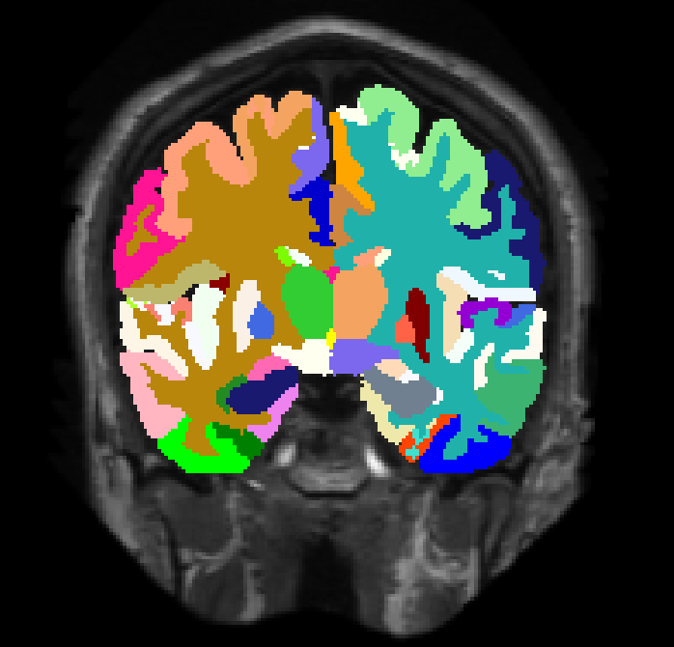
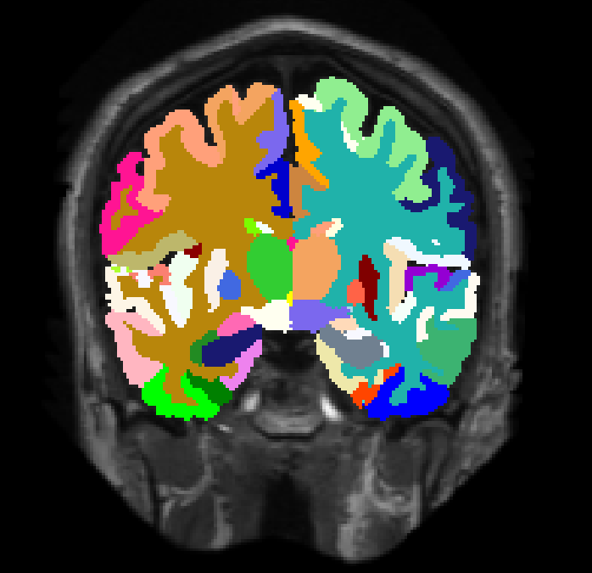
Joint label fusion yields outstanding segmentation performance especially when combined with additional voxel-wise intensity-based error correction (Wang et al., 2011)
Input image
Manual
Joint label fusion
Joint label fusion + corrective learning
Warfield, Landmann et al., MICCAI 2012 Multi-Atlas Labeling Challenge
Notes:
Consurso de segmentaction en MICCAI

Slide 11
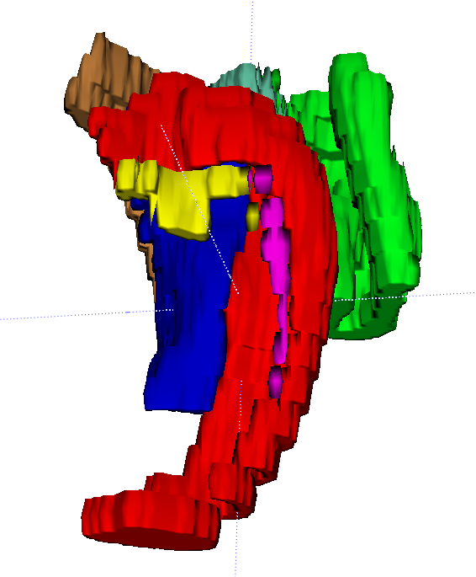
ASHS: A multi-atlas pipeline optimized for labeling the hippocampal region in high-resolution T2-weighted MRI
Inputs:
High-resolution T2-w MRI
1mm resolution T1-w MRI
Algorithms:
ANTS deformable registration¹
Joint label fusion²
Corrective learning³
Output:
Segmentation of hippocampal subfields and MTL cortices in the space of the T2-w MRI
¹: Avants et al., MedIA, 2006; ²: Wang et al., Pattern Anal Mach Intell, 2012; ³: Wang et al., Neuroimage, 2011

Slide 12
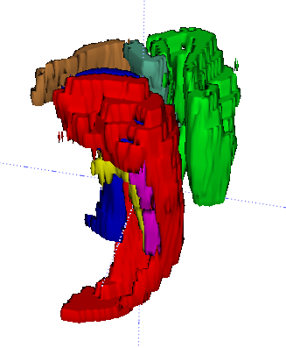
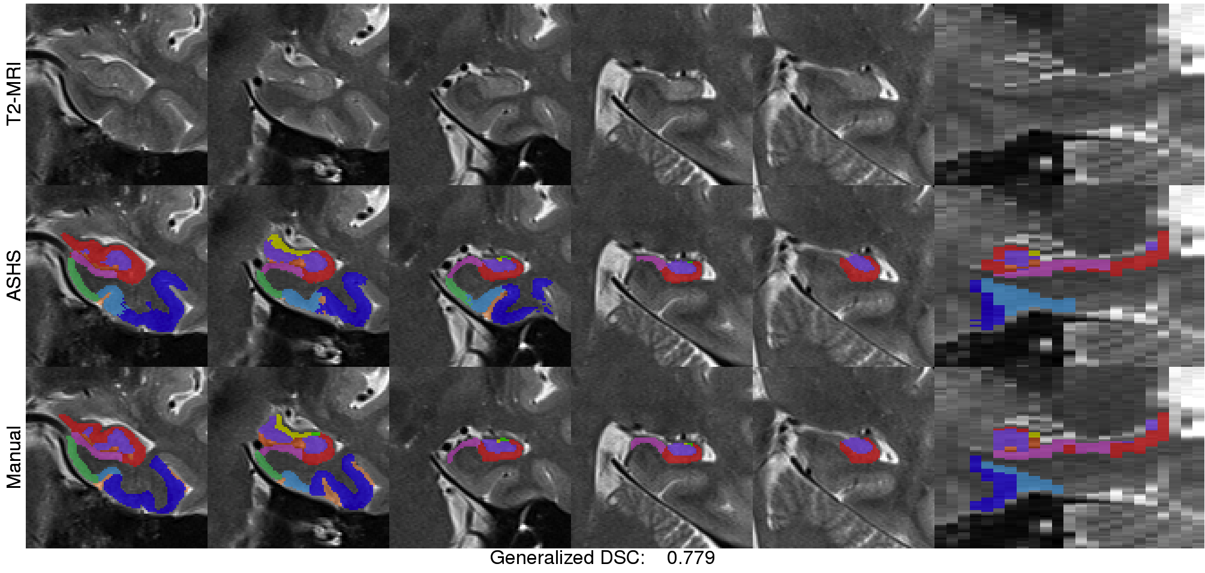
ASHS Performance vs. Manual Segmentation
Yushkevich et al., Human Brain Mapping,2014
1cm
Notes:
Here is one case shows the average performance of ASHS.
The overall performance is competitive with inter rater manual segmentation reliability.
However, the thick slice posts challenge to shape analysis and thickness measurement.
PY: edited title to emph. That performance is vs. manual segmentation

Slide 13
Joint label fusion without dense deformable registration
95-99% of computational time is spent in registration
Only a fraction of the information in the deformation field is used for the fusion process
Diffeomorphic constraints may be too restrictive
Don’t make sense in presence of lesions, etc.

Slide 14
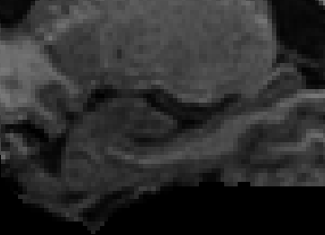
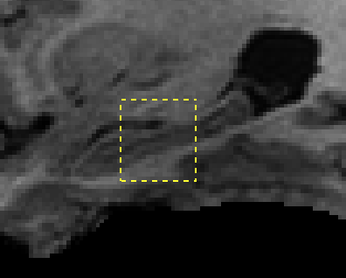
A spectrum of approaches for generating candidate matches for a target voxel
?
How to find good candidate matches in the atlas library for the voxel at the center of this patch?
Atlas library
A patch in the target image
Amount of Spatial Context
Deformable Registration
PatchMatch (Coupe et al., 2014)
SuperVoxel MRF
Affine registration with local patch search (Coupe et al., 2010)
SuperVoxel matching (Wang et al., 2013)
Global search over all patches in all atlases

Slide 15
Wang et al., 2013 MICCAI: Label Transfer via Supervoxel Matching
Search space of candidate patches for a given target voxel is reduced by global supervoxel matching
Atlas and target image divided into supervoxels
Supervoxels most similar to the target supervoxel are found (based on attribute vector)
Patches from selected supervoxels are used for voxel-level joint label fusion
atlas SV
atlas
atlas
atlas SV
atlas SV
target
Target SV
Notes:
Work in Schnabel somewhere

Slide 16
Wang et al., 2013 MICCAI: Label Transfer via Supervoxel Matching
Search space of candidate patches for a given target voxel is reduced by global supervoxel matching
Atlas and target image divided into supervoxels
Supervoxels most similar to the target supervoxel are found (based on attribute vector)
Patches from selected supervoxels are used for voxel-level joint label fusion
Method largely serves as a proof of concept that joint label fusion can be applied without registration
Allowed label fusion segmentation of brain tumors
Fails for most problems where spatial context is needed for segmentation
Notes:
Work in Schnabel somewhere

Slide 17
Proposed method: SV matching with spatial context
Affine alignment
To get corresponding anatomy roughly into place
Supervoxel oversegmentation (atlas and target)
Uses the SLIC algorithm – supervoxels of consistent size and shape
Discrete MRF supervoxel registration
Uses FastPD to quickly match supervoxels respecting spatial relationships
Voxel-level refinement
Patch-based joint label fusion with MRF prior
Learning-based error correction

Slide 18
Details of the method
supervoxel-level pre-segmentation
atlases pre-processing
start
atlases
N3 correction
FLIRT affine registration
histogram matching
supervoxel generation
supervoxels
voxel-level refinement
training samples
label probability distribution
supervoxel correspondences as prior knowledge
label transfer
learning-based error correction
voxel-level MRF
joint label fusion
voxel-level kNN
supervoxel-level MRF
final segmentation
end
target image pre-processing
target image
start
N3 correction
FLIRT affine registration
histogram matching
supervoxel generation
supervoxels

Slide 19
Details of the method
supervoxel-level pre-segmentation
atlases pre-processing
start
atlases
N3 correction
FLIRT affine registration
histogram matching
supervoxel generation
supervoxels
voxel-level refinement
training samples
label probability distribution
supervoxel correspondences as prior knowledge
label transfer
learning-based error correction
voxel-level MRF
joint label fusion
voxel-level kNN
supervoxel-level MRF
final segmentation
end
target image pre-processing
target image
start
N3 correction
FLIRT affine registration
histogram matching
supervoxel generation
supervoxels

Slide 20
Details of the method
supervoxel-level pre-segmentation
atlases pre-processing
start
atlases
N3 correction
FLIRT affine registration
histogram matching
supervoxel generation
supervoxels
voxel-level refinement
training samples
label probability distribution
supervoxel correspondences as prior knowledge
label transfer
learning-based error correction
voxel-level MRF
joint label fusion
voxel-level kNN
supervoxel-level MRF
final segmentation
end
target image pre-processing
target image
start
N3 correction
FLIRT affine registration
histogram matching
supervoxel generation
supervoxels

Slide 21
Supervoxel correspondence matching
Recent related work:
Kanavati et al., MLMI 2015
Finds correspondences between supervoxels in two images using random forests
Can serve to initialize dense registration or for multi-atlas segmentation
No spatial prior on the correspondence field
Heinrich et al., MedIA 2016
Multiple supervoxel graphs
Discrete MRF-based supervoxel registration
Unifies registration and label fusion

Slide 22
Discrete MRF-based supervoxel matching
Search space: discrete set of displacements from target supervoxel centers
Data term: how similar is supervoxel P to the supervoxel in atlas A pointed to by
Binary potential: how similar are displacements at adjacent supervoxels
P,Q; weighted by the proximity and area of border between P and Q.
target image T
atlas A
P
Q
Minimized using FastPD (Glocker et al. 2008)

Slide 23
Details of the method
supervoxel-level pre-segmentation
atlases pre-processing
start
atlases
N3 correction
FLIRT affine registration
histogram matching
supervoxel generation
supervoxels
voxel-level refinement
training samples
label probability distribution
supervoxel correspondences as prior knowledge
label transfer
learning-based error correction
voxel-level MRF
joint label fusion
voxel-level kNN
supervoxel-level MRF
final segmentation
end
target image pre-processing
target image
start
N3 correction
FLIRT affine registration
histogram matching
supervoxel generation
supervoxels

Slide 24
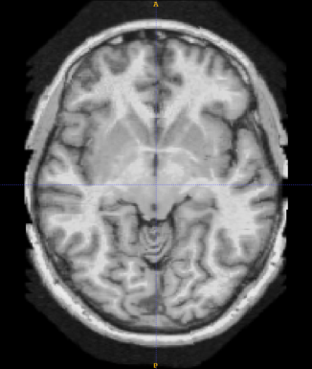
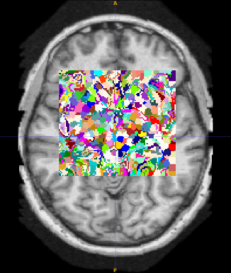
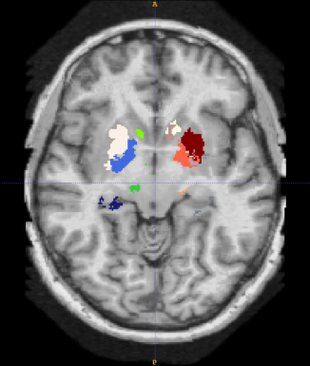
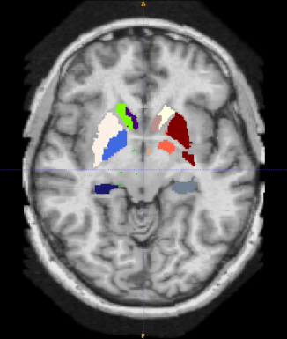

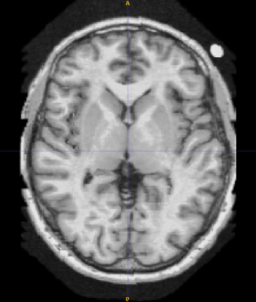
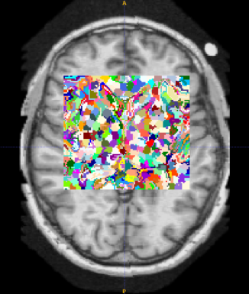
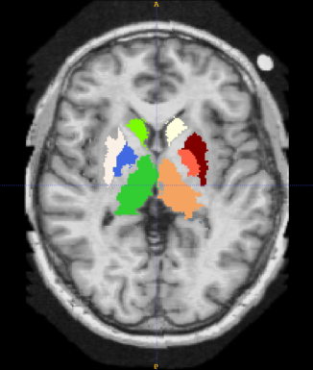
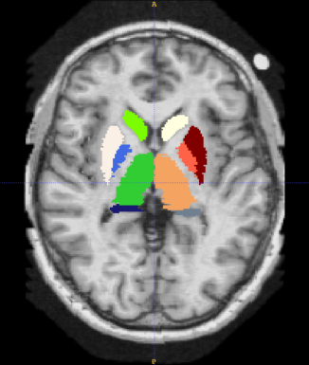
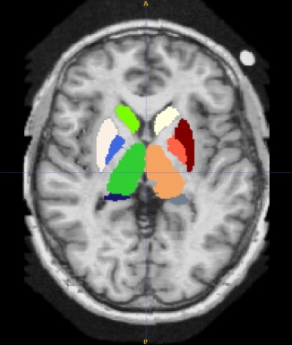
Evaluation: multi-label diencephalon segmentation MICCAI 2013 SATA Challenge Dataset (Asman et al., 2013)
35 atlases, 12 testing images, 14 labels
T1
Supervoxels
Supervoxel-level pre-segmentation
Final segmentation
Ground truth

Slide 25
Evaluation: multi-label diencephalon segmentation MICCAI 2013 SATA Challenge (Asman et al., 2013)
Leave-one-out segmentation accuracy relative to manual segmentation on the (n=35) training set

Slide 26
Experiments: Effectiveness of SV-Level MRF
Supervoxel Level
Voxel Level
Average DSC
Average DSC
Wang et al., 2013 supervoxel method
Barnes et al. 2009 applied to SVs
Our approach
Straw man
JLF without MRF regularization
Our approach

Slide 27
Experiments: Trade-Off between Accuracy and Efficiency
In parallel on a cluster
Only 5s in FastPD
Evaluation on the SATA test dataset

Slide 28
Discussion and Conclusions
Seeding JLF with fast supervoxel matching can approach the accuracy of multi-atlas segmentation with dense deformable registration
There is potential to speed up segmentation time by orders of magnitude
Only 5s spent in FastPD algorithm, most of the time spent preprocessing
Important to validate in more relevant and challenging problems
E.g., body CT segmentation, where diffeomorphic registration assumptions may not hold
Can the method be useful for segmenting pathology?

Slide 29
Thank you!
Email: pauly2@upenn.edu
Web: http://picsl.upenn.edu

Slide 30
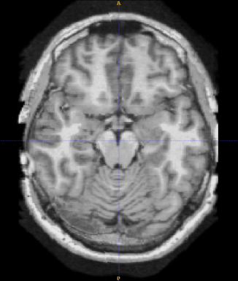
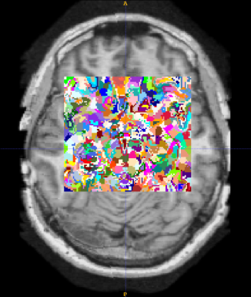
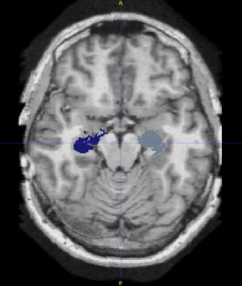
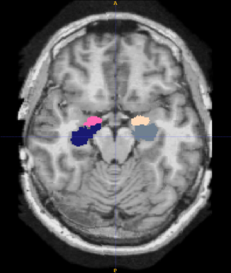
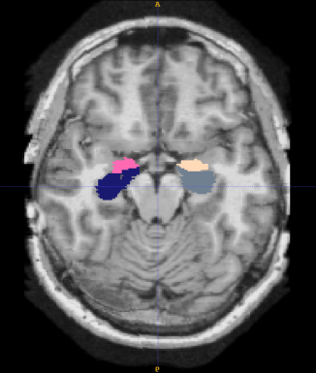
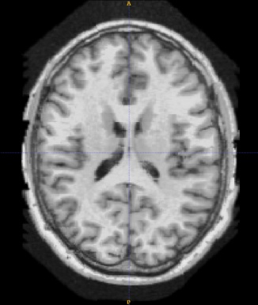
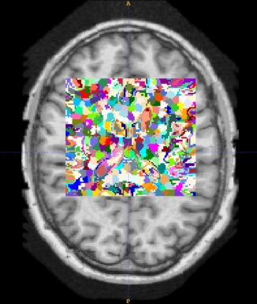
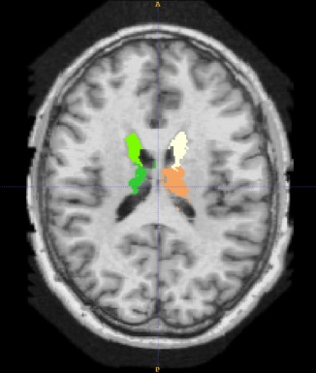
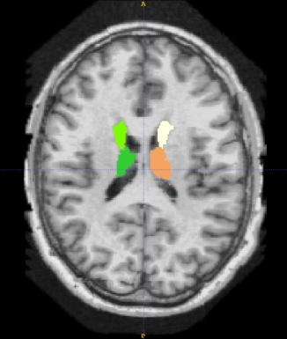

T1
Supervoxels
Supervoxel-level pre-segmentation
Final segmentation
Ground truth

Slide 31
Method: Pre-Processing
For both atlas and target images
N3 correction
→ homogeneity
Affine registration to ICBM152 via FLIRT
→ spatial regularization
→ fast but low accuracy
Histogram matching to ICBM152
→ intensity regularization

Slide 32
Method: Supervoxel-Level Pre-Segmentation
Why supervoxels?
Adhering to natural boundaries >> regular patches
Compact and concise representation >> voxels
Robust label transfer >> voxel label transfer
Narrowing down valid regions for voxel-level refinement

Slide 33
Method: Voxel-Level Refinement
MRF solver: FastPD [Glocker et al., MedIA 2008]
→ Supervoxel pair to each of atlases
→ Supervoxel label transfer: majority voting
→ Only consider voxels inside valid target supervoxels
→ kNN voxel-surrounding patch neighbors
→ Voxel label transfer: joint label fusion [Wang et al., PAMI 2013]
→ Label probability vector v_{p}(l_{p})
Data term
Smoothness term

